Slide 1
Мөнгө чухал
Номлогчийн үгс 5:8–6:9
Dr. Rick Griffith, Crossroads International Church
www.biblestudydownloads.org

Slide 2
Мөнгө аз жаргалд хүргэх үү?

Slide 3
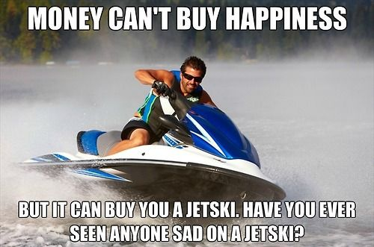
Title
Мөнгө аз жаргалыг худалдаж авч чадахгүй
Гэхдээ мөнгөөр усны мотоцикл авч болно. Усны мотоциклтой хүн урвайж байхыг харсан уу?

Slide 4
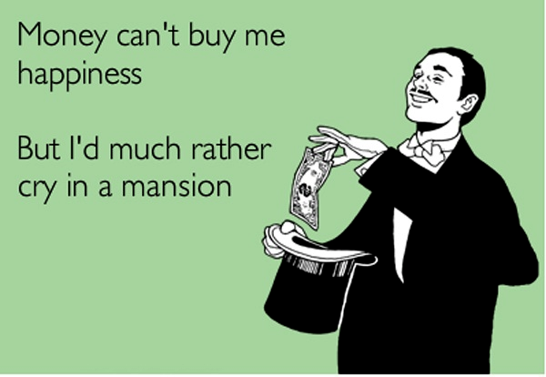
Title
Мөнгө аз жаргалыг худалдаж авч чадахгүй
Гэхдээ л миний хувьд хувийн шилтгээнд уйлж байсан нь дээр!

Slide 5
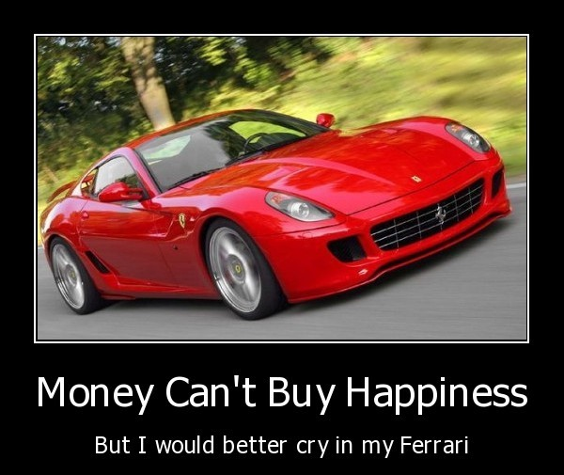
Title
Мөнгө аз жаргалыг худалдаж авч чадахгүй
Гэхдээ миний хувьд феррари дотор уйлсан нь дээр

Slide 6
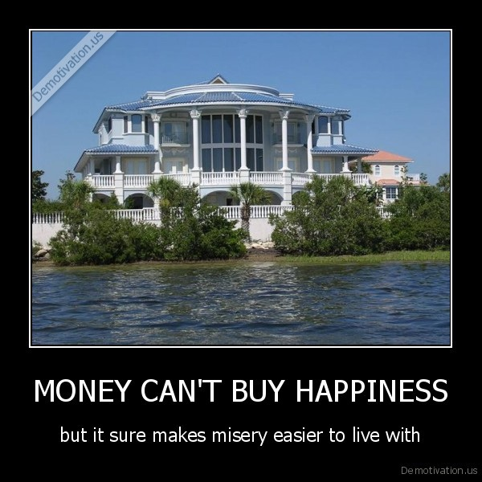
Title
Мөнгө аз жаргалыг худалдаж авч чадахгүй
Гэхдээ л ямар ч зовлон тохиолдсон мөнгө үүнийг хялбархан болгодог ш дээ!

Slide 7
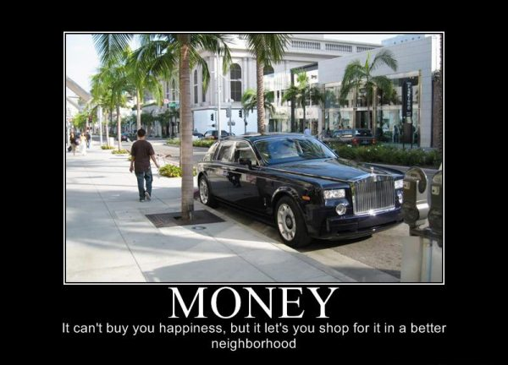
Title
Мөнгө аз жаргалыг худалдаж авч чадахгүй
Гэхдээ мөнгөтэй байхад тухлаг газар ч амьдарч, шоппинг хийхэд ч зугаатай ш дээ!

Slide 8
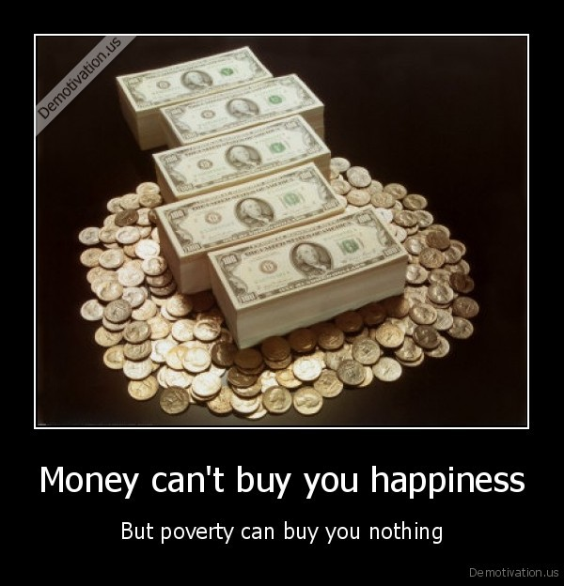
Title
Мөнгө аз жаргалыг худалдаж авч чадахгүй
Гэхдээ ядуу байдал таньд юуг ч авч өгөхгүй!

Slide 9
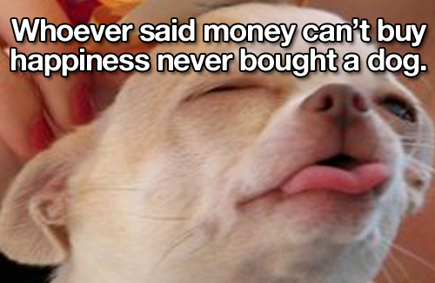
Title
Мөнгө аз жаргалыг худалдаж авч чадахгүй гэдэг хүмүүс нохой ч авч үзээгүй дээ

Slide 10
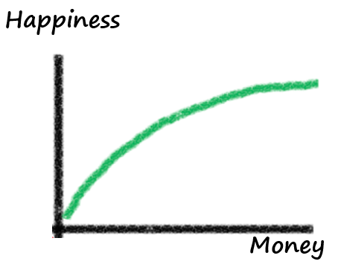
Илүү мөнгө = Илүү аз жаргал?
Аз жаргал
Мөнгө
Notes:
"The idea here is that while controlling for other factors that might influence happiness, a person's level of happiness should increase with the level of money that they possess. The same also applies to other items that are 'good' and also experiences. If you love chocolate, then two pieces of chocolate are better than one piece. If a holiday is enjoyable, two weeks on a holiday are better than only one week.
The happiness associated with money or the amount of a good thing does not increase in a straight line. The relationship is curved so that the more of something that you already have, the harder it is to increase your level of happiness by having more of it. So going from $10,000 to $20,000 yields a lot more happiness than going from $1,000,000 to $1,020,000. The second chocolate is not quite as enjoyable as the first one (unless you are a very serious chocoholic!). The second week on holiday doesn't bring quite as much relaxation benefits or fun as the first week. Economists call this diminishing marginal utility because the additional satisfaction (marginal utility) from having more of something diminishes with each additional unit. In other words, the additional happiness from one more dollar will be lower than it was for the previous dollar.
Now this all might make a lot of sense. The problem is that people simply don't assess happiness or satisfaction this way on a day-to-day basis. Sure, when people with more money are asked to take stock of their lives, they give the 'socially right' answer by saying that they are happier. However, when asked how happy they are at any particular point of time, people with more money are barely different to those with less money [Diener, Ng, Hartner and Arora (2010)].
So while this classical view of the relationship between money and happiness might make a lot of sense, it is completely wrong!"
Adapted from http://ahingston.wordpress.com/2012/12/14/money-and-happiness/

Slide 11
Илүү мөнгө = Илүү жаргал?
Бат
$300,000
Баяр
$500,000
Гонгор
$1,000,000
Notes:
I'd like you to conduct a quick thought experiment. Imagine three people: John, David and Barry. For the sake of the thought experiment, I'd like you to imagine that their lives are pretty much the same. They are all equally satisfied with their jobs, they are physically healthy and are all equally happy with their family and relationships. They drive the same type of cars and live in similar houses. Their lives are basically the same.
The only thing that is different is how much money they have. John has $300,000, David has $500,000 and Barry has $1,000,000.
Adapted from http://ahingston.wordpress.com/2012/12/14/money-and-happiness/

Slide 12
Илүү мөнгө = Илүү жаргал?
Бат
Одоо $300,000
Урьд $200,000
Баяр
Одоо $500,000
Урьд $500,000
Гонгор
Одоо $1,000,000
Урьд $2,000,000
Notes:
"To illustrate why the classical view of the relationship between money and happiness is so wrong, let me add one more piece of information to our earlier thought experiment. One year ago, John had $200,000, David had $500,000 and Barry had $2,000,000. Do you see how this extra piece of information changes things quite a bit? John might only have $300,000 but he feels as though things are much better now. He has gained $100,000 in money over the last year. Indeed he has increased his money by 50% in one year and feels good about it. David has the same amount of money that he had one year ago. He is pretty neutral about his money since nothing has changed. He neither feels a sense of gain nor a sense of loss. Barry, on the other hand, is the least happy of the three. In fact, he is very annoyed. Last year he had $2,000,000 but he has lost half of it! He feels as though he has gone backwards."
Adapted from http://ahingston.wordpress.com/2012/12/14/money-and-happiness/

Slide 13
Хэрэв мөнгө аз жаргал авчирдаг бол, баян хүн…
илүү сайн найзуудтай
гэр бүл салалт байхгүй
илүү инээмсэглэл
илүү инээд хөөр
зугаацах илүү цаг
амьдрал нь илүү утга учир, зорилготой

Slide 14
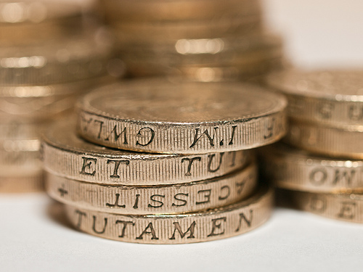
Бид мөнгийг хэрхэн үзэх ёстой вэ?

Slide 15
Money Matters
МӨНГӨ ЧУХАЛ

Slide 16
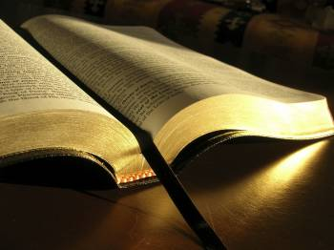
Соломон мөнгөний тухай Ном 5:8–6:9

Slide 17
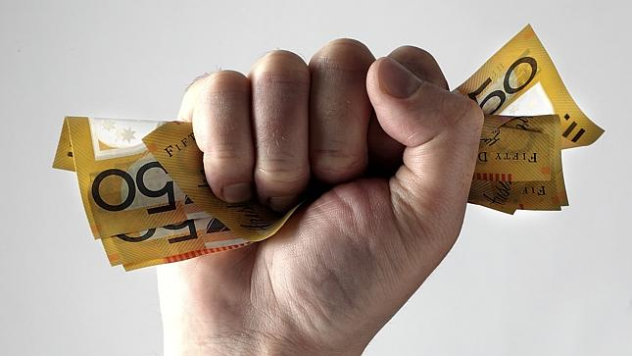
I. Зарим муу түшмэд эд баялгаар туйлахад бүү гайх (5:8-9).

Slide 18
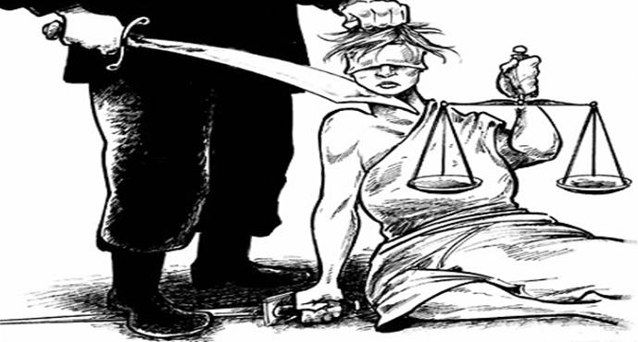
A. Хавлага, үнэний үгүйсгэлд гайхах шаардлагагүй (5:8a).
B. Шунал, дарамт засгийн аль ч түвшинд байж л байдаг (5:8б-9).

Slide 19
Арабын "Н" үсгийг (Христэч гэсэн үгийн эхний үсэг) Христитгэгчдийн гэрийн гадна сүйрүүлэхийн тулд зурдаг

Slide 20
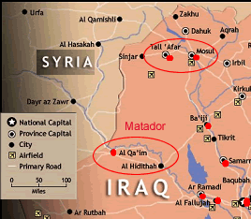
Map

Slide 21
I. Зарим муу түшмэд эд баялгаар туйлахад бүү гайх (5:8-9).

Slide 22
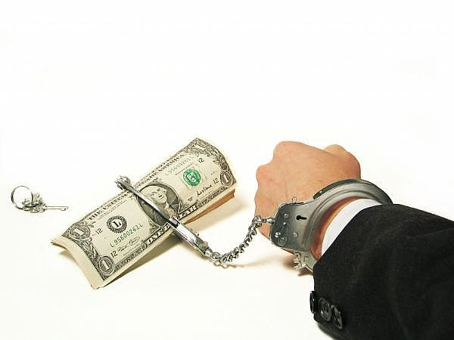
II. Материализм нь олон гашуун үр дагаварт хүргэнэ (5:10-17)

Slide 23
Сэтгэл хангалуун бус: "Мөнгийг хайрлагч нь мөнгөнд үл ханах ба элбэг дэлбэгийг эрхэмлэгч нь орлогодоо эс цадах. Энэ нь бас л хоосон!" (5:10).
Материализмийн гашуун үр дагавар

Slide 24
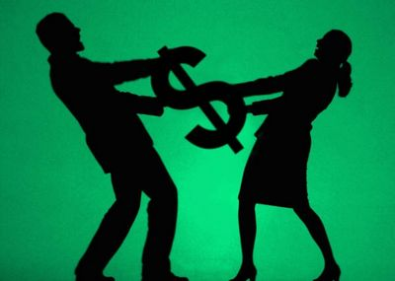
Гэр бүлийн зөрчил
Материализмийн гашуун үр дагавар

Slide 25
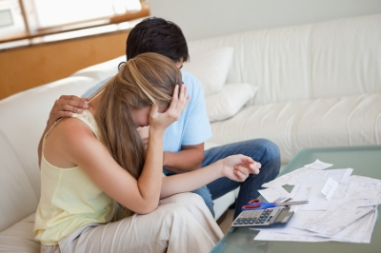
Мөнгөндөө тааруулахгүй хэрэглээ
Материализмийн гашуун үр дагавар

Slide 26
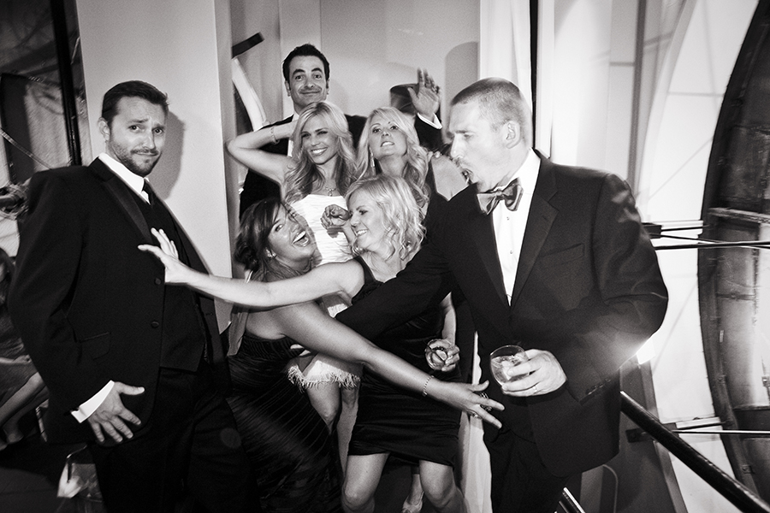
Өндөр зардал: "Баялаг өсөхийн хэрээр залгигсад олшрох бөгөөд …" (5:11a).
Материализмийн гашуун үр дагавар

Slide 27
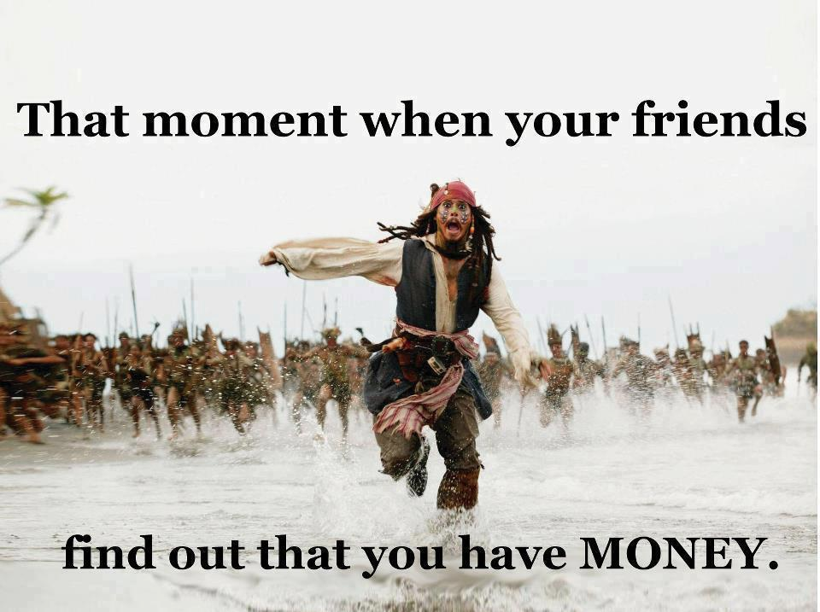
"The more you have, the more people come to help you spend it…" (5:11a NLT).
Материализмийн гашуун үр дагавар
Найзууд чинь чамайг
мөнгөтэй гэдгийг олж мэдэх үед!

Slide 28
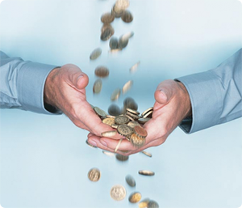
"…тэдгээрийг хараад суух нь өмчлөгчийн ашиг нь юм гэж үү?" (5:11)
Материализмийн гашуун үр дагавар

Slide 29
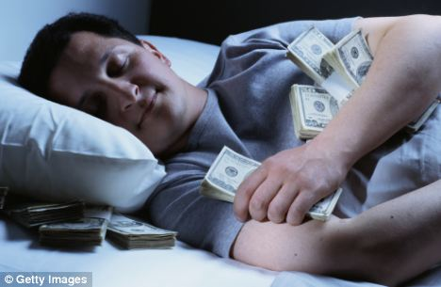
Үнэн үү?
Материализмийн гашуун үр дагавар

Slide 30
Нойргүйдэл: "Их ч идсэн, бага ч идсэн ажилчин хүний нойр таатай байдаг атал баян хүний цатгалан гэдэс өөрийг нь унтуулдаггүй ажээ" (5:12).
Материализмийн гашуун үр дагавар

Slide 31
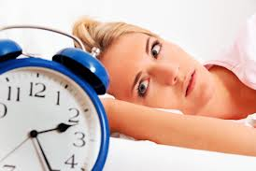
Мөнгөнөөс болж нойргүй?
Материализмийн гашуун үр дагавар

Slide 32
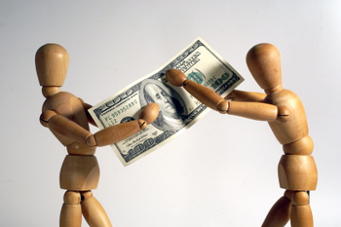
"Наран доор би нэгэн гунигийг харлаа. Хураасан баялаг нь эзэндээ гай авчирдаг" (5:13).
Материализмийн гашуун үр дагавар
Өөрт лай зовлон авчрах?

Slide 33
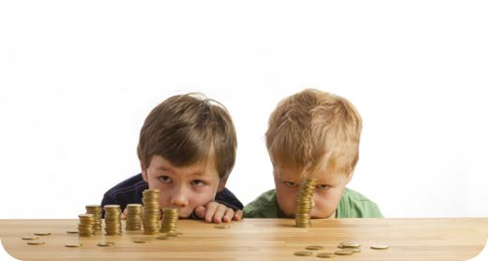
"Ийм хөрөнгө гай болж сүйрэхэд, хүүгийнх нь гарт юу ч үгүй хоцрох аж" (5:14).
Материализмийн гашуун үр дагавар
Хөрөнгө юу ч өвлүүлж чадахгүй

Slide 34
Дараагийн амьдралд юу ч үгүй: "Хүн эхийн хэвлийгээс нүцгэн ирээд, ирсэн шигээ нүцгэн буцаж явдаг. Тэрээр зүтгэлээсээ гартаа аваад явчих юу ч үгүй л арилах аж. Хүн ирсэн шигээ л буцаж явах болдог нь мөн л эмгэнэлтэй хэрэг. Ингэвэл салхины төлөө зүтгэгч хүнд ямар ашиг байна?" (5:15-16).
Материализмийн гашуун үр дагавар

Slide 35
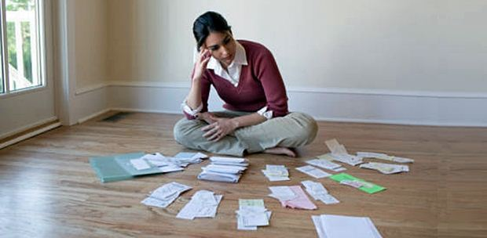
"Тэрээр бүхий л өдрөө харанхуйд хооллож, үлэмж уй гашуу, өвчин, уур уцаартай байдаг" (5:17).
Материализмийн гашуун үр дагавар

Slide 36
I. Зарим муу түшмэд эд баялгаар туйлахад бүү гайх (5:8-9).

Slide 37
II. Материализм нь олон гашуун үр дагаварт хүргэнэ (5:10-17)

Slide 38
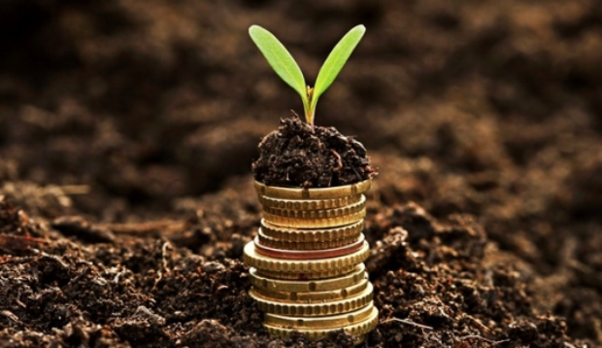
III. Бурхан өөрийг нь болон бусдыг баяртайгаар хэрэглүүлэхийн тулд мөнгө өгдөг (5:18–6:9).

Slide 39
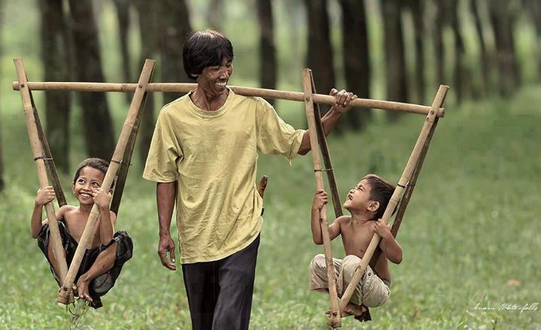
"Харин миний харсан сайн зүйл гэвэл идэх, уух хийгээд Бурханаас өөрт нь өгөгдсөн амьдралынхаа
бүхий л өдрийн турш наран доор зүтгэсэн бүх зүтгэлээрээ өөрийгөө баясгах явдал байлаа. Учир нь энэ түүний хувь хишиг аж" (5:18).

Slide 40
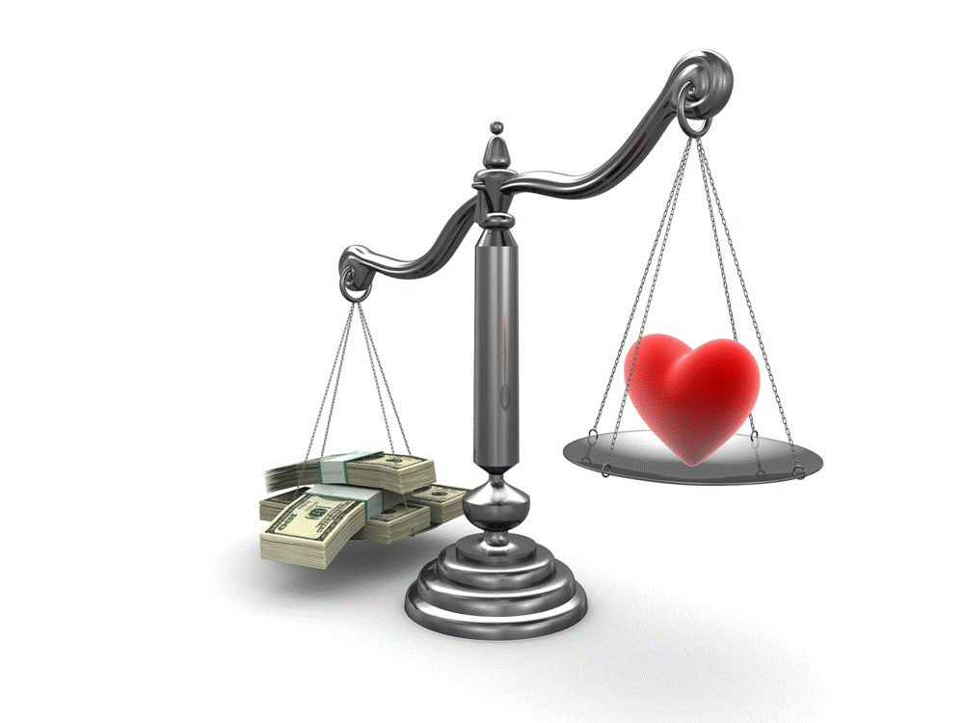
"Баян гэдэг бол зарцуулахаасаа ихийг олдог хүнийг, ядуу гэдэг нь зардал нь олохоосоо давсан хүнийг хэлдэг."

Slide 41
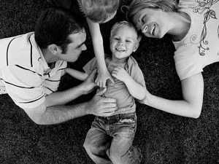
Байгаагаараа хамт буй хүмүүстэйгээ сэтгэл хангалуун бай

Slide 42
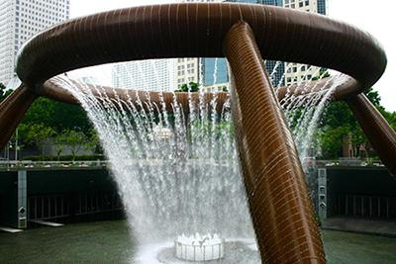
Бурхан заримыг нь эд баялагтаа баясах боломж өгдөг, энэ нь Бурханы бэлэг (5:19-20).

Slide 43
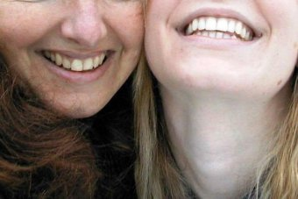
"Бурханаас эд баялаг, хөрөнгө зоорь авсан хүн бүрд Тэр тэдгээрийг эдэлж, хэрэглэх эрх олгож мөн өөрийн зүтгэлд баярлаж, хувь хүртэхийг зөвшөөрдөг. Энэ нь Бурханы бэлэг мөн" (5:19).

Slide 44
"Бурхан зүрхийг нь баяр баясгалантай байлгадаг тул тийм нэгэн амьдралынхаа хоногуудад үргэлж санаашраад байдаггүй" (5:20).
Website

Slide 45
Олон хүнийг баялаг, нэр алдраар зугаацахыг Бурхан зөвшөөрдөггүй (6:1-2).

Slide 46
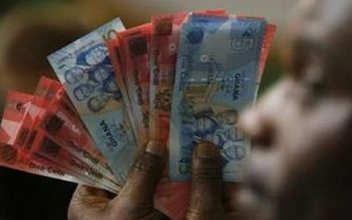
"Наран доор миний харсан нэг муухай юм хүмүүн дээр хүндээр буудаг аж. Хүсэл мөрөөдлөөс нь юу ч дутаалгүйгээр хүнд эд баялаг, хөрөнгө мөнгө, нэр алдрыг Бурхан өгчихөөд харин тэдгээрийг эзэмших эрхийг үл өгснөөр харь хүн түүнийг нь эдэлж баясах аж" (6:1-2).

Slide 47
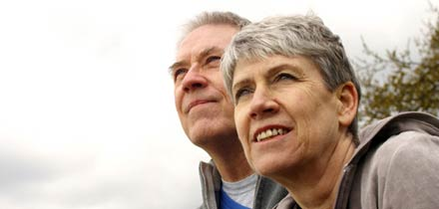
Хэрэв та өөрт байгаагаараа баясахгүй л бол, амьдралд сэтгэл хангалуун байж чадахгүй (6:3-9).

Slide 48
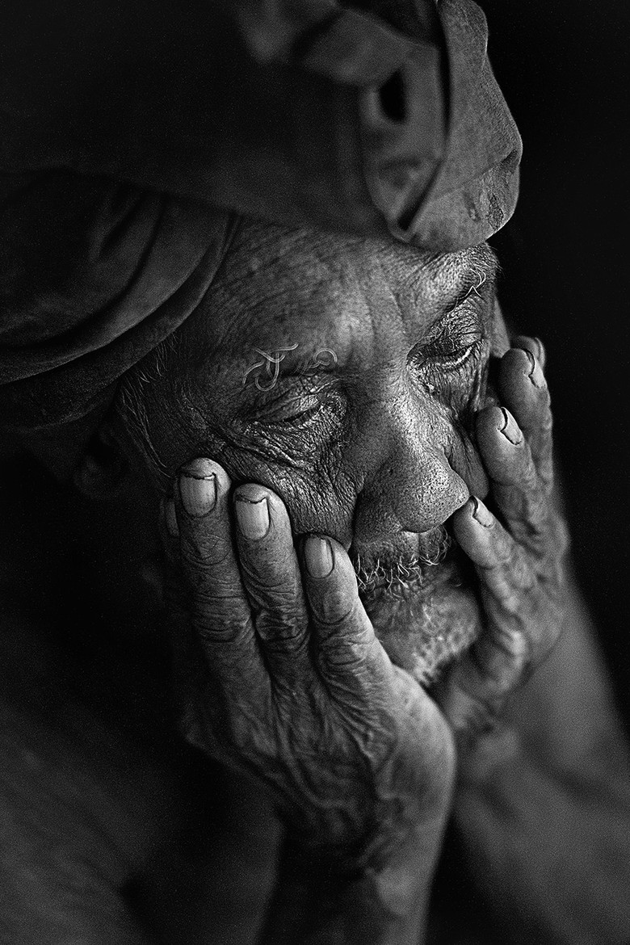
"Хүн зуун хүүхдийн эцэг болсон ч бай, олон жил амьдарсан ч бай, хэрэв сэтгэл нь сайн юманд баясаж эс чадаад, оршуулга нь зохих ёсоороо болоогүй бол тэр хүний амьдралын өдрүүд олон байсан ч 'амьгүй төрсөн хүүхэд түүнээс дээр юм даа' гэж би хэлнэ" (6:3).

Slide 49
"Ийм төрсөн нэгэн хоосон руу ирээд, харанхуй руу одож, нэр алдар нь ч харанхуйд хучигдсан болой. Тэр нарыг хэзээ ч үзээгүй, мэдээ ч үгүй оджээ. Гэвч энэ нь нөгөөхөөсөө илүү дээр аж" (6:4-5).

Slide 50
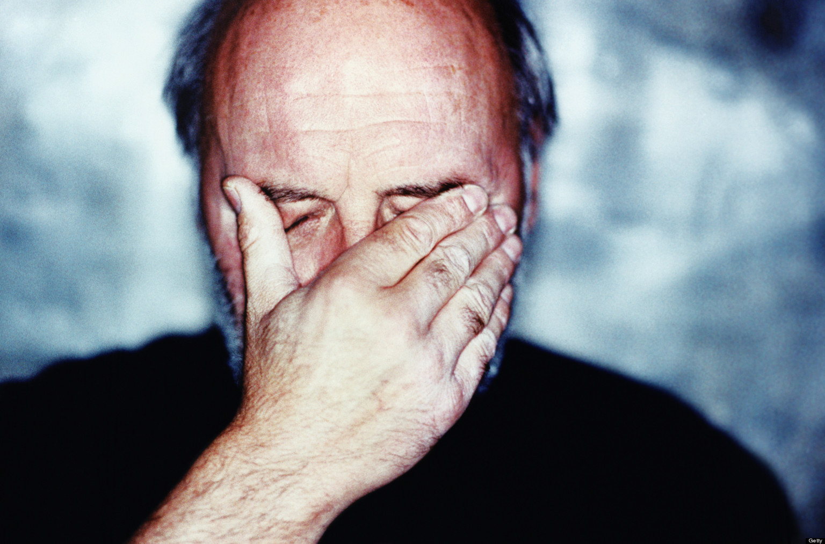
"Гэтэл өөр хүмүүс хоёр мянган жил амьдарсан агаад сайныг үл амссан байлаа ч тэд бүгд нэг л газар уруу явдаггүй гэж үү?" (6:6).

Slide 51
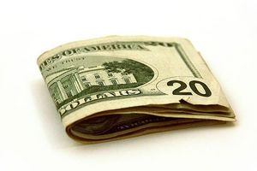
Мөнгөндөө цадаж ханадаггүй хүмүүст амьдрал нь утгагүй (6:7-9).

Slide 52
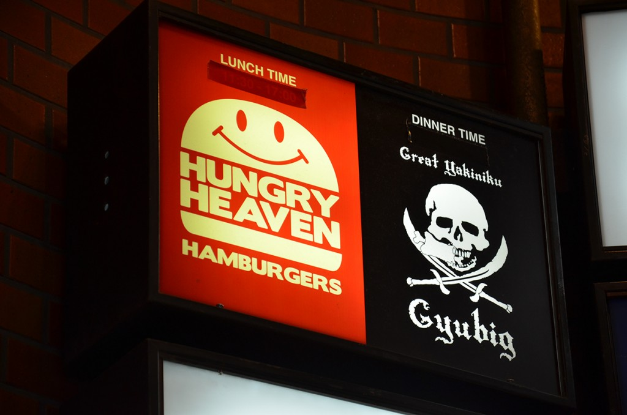
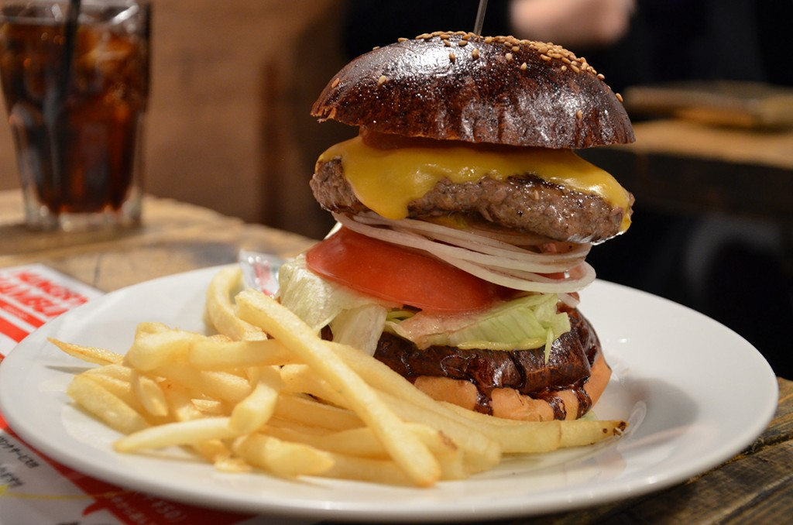
"Хүний бүх л зүтгэл амандаа л зориулагдах боловч хүсэл ханах нь үгүй ажээ" (6:7).

Slide 53
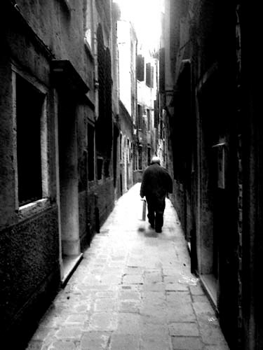
"Ухаантан нь тэнэгээсээ юугаараа илүү юм бэ? Амьд байгсдын өмнө хэрхэн явахаа мэдэх нь ядуу хүнд ямар ашиг өгөх юм бэ?" (6:8)

Slide 54
"Нүд юу харж байгаа нь сэтгэл юу хүсэж байгаагаас илүү чухал юм" (6:9a).

Slide 55
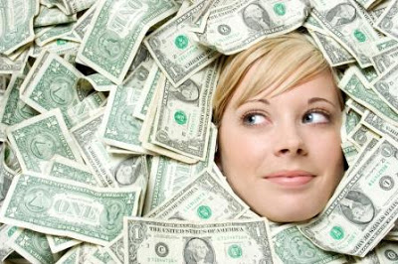
"Зүгээр л сайн зүйлсийн талаар мөрөөдөх нь утгагүй—салхи хөөж байгаа мэт" (6:9б орчуулга).

Slide 56
Мөнгөний талаар бид юу гэж үзэх ёстой вэ?

Slide 57
5:8–6:9 Гол санаа
Материализм нь олон муу үр дагавартай боловч бурханлаг хүн эд баялгаар жаргалтай амьдарч чадна.

Slide 58
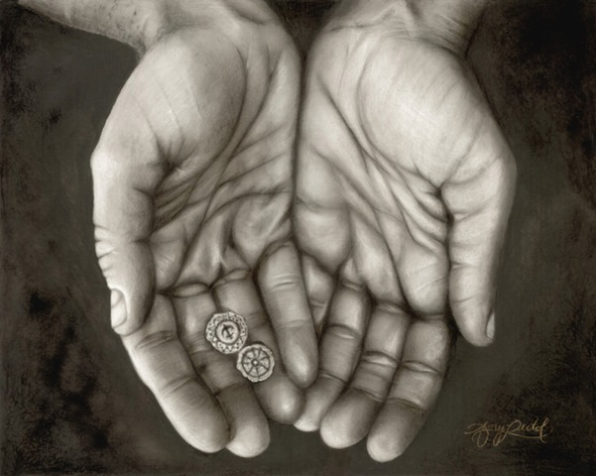
Мөнгөний талаарх гурван үнэн…

Slide 59
I. Зарим муу түшмэд эд баялгаар туйлахад бүү гайх (5:8-9).

Slide 60
II. Материализм нь олон гашуун үр дагаварт хүргэнэ (5:10-17)

Slide 61
III. Бурхан өөрийг нь болон бусдыг баяртайгаар хэрэглүүлэхийн тулд мөнгө өгдөг (5:18–6:9).

Slide 62
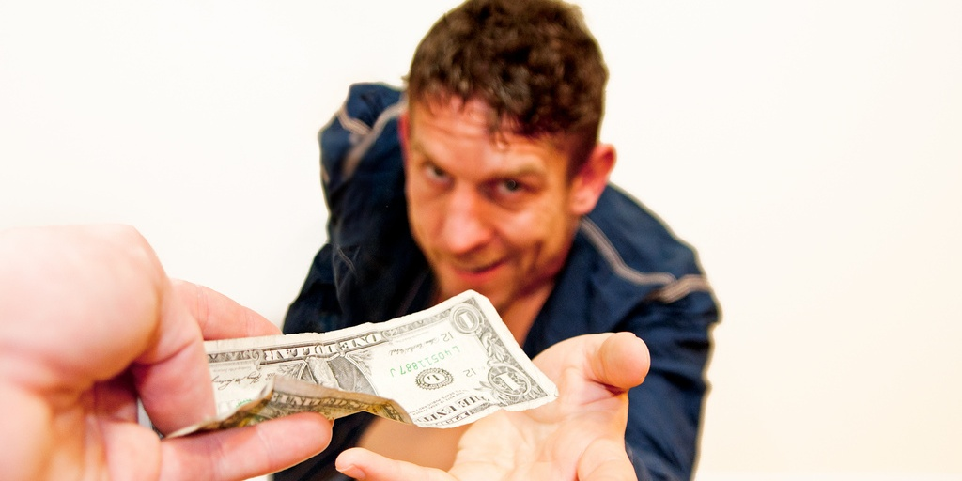
Та сэтгэл хангалуун байна уу?

Slide 63
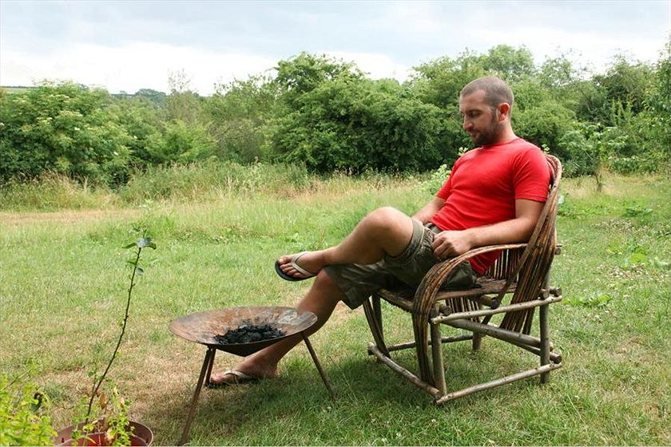
Мөнгөгүй хүн ч аз жаргалыг мэдэрдэг
Notes:
Moneyless man finds happiness
Mark Boyle ABC Environment 9 Oct 2013
Mark Boyle believes that a life free of money liberates and inspires. Credit: Jose Lasheras (supplied)
See also
Related Story: The man who lives without money Mark Boyle 12 Apr 2010
Comments (174) Mark Boyle, a man who 5 years ago decided to live without money, is surviving and thriving. He has plans for a new venture and he just got engaged.
IT WAS 2008 and news of the deep-rooted problems in the financial industry had begun to hit the headlines. People were losing their jobs and their homes, and the institutions we perceived to be the bedrock of our society were crumbling around us. Within days we were on the verge of an "economic meltdown". Whilst my heart despaired for the ordinary people's lives that were being drastically affected by decisions made outside of their control, I remained insulated from it all through the unlikeliest of routes: I had just begun living completely without money.
Up to that point I had spent years feeling overwhelmed by the horrors I was witnessing around me — the mass extinction of species, homogenisation of cultures, mechanisation of our livelihoods and the general flat-packing of the Earth along the assembly line of industrial civilisation. I wanted to do something to act as a counter-friction to the cogs of the machine economy, which I believed were reducing our beautifully diverse world to cold, inanimate numbers. But as globalisation disempowers us through its sheer scale, I, like most of us, had absolutely no idea what meaningfully to do about any of it.
That all changed one day, after a long process of inquiry. I came to the understanding that, in general terms, these issues had a common denominator: they were symptoms of our perceived separation from the natural world and each other. This can seem like an abstract concept to grasp, but at its heart it means that, through various means, we have convinced ourselves that our own health is not dependent on the health of the Earth as a whole, and that somehow our fate is not linked to that of the intricate web of life we're inextricably dependent on. Through this realisation came a second one: that money is the most potent tool we possess in creating and perpetuating this illusion of separation and independence.
Through its function as a medium of exchange, money allows us to consume products with components or ingredients from all over the Earth. On a short-term and often superficial level, this can seem like it has many benefits. What wasn't being spoken about at the time, however, were the unintended consequences of money, and like all technologies, it has far-reaching and deep consequences. Apart from its widely ignored psychological, emotional, spiritual and physical effects on us personally, it also affords us an unwise buffer from the abuses and massacres that occur throughout the supply chains of the products we consume, and all the social and ecological problems associated with that.
After speaking out about these for a time, I began to feel that talk was cheap. I was also embroiled in the world of money as much as the next person, and so my arguments felt arrogant and theoretical. How could I know if a life without money was even possible or desirable, and if it was, how would it feel as a human to live without money in a world increasingly addicted to it? So in 2008 I decided to live without money, as a one year experiment initially. It became the greatest experience of my life.
A lot has changed since I started out on this path, both in myself and the world around me. As the financial world began to crumble, it became clear to me that this 'economic meltdown' was a misnomer; what it was, in fact, was a 'financial meltdown'. Politicians and economists alike have been conflating 'finance' with 'economics' for so long that we can now only imagine an economy facilitated by money.
The man who lives without money "If someone told me seven years ago, in my final year of a business and economics degree, that I'd now be living without money, I'd have probably choked on my microwaved ready meal..." Read the first part of Mark's story here. However, despite the headlines, another model — what anthropologists refer to as gift culture — was filling the void left by the dearth of money and credit. Economics, contrary to popular opinion, has very little to do with money; it is simply a social science concerned with how we meet our needs. Money is obviously one way of doing this. What I began learning in 2008 was that there are no end of ways you can meet your needs without money, and more than one way of being human in this world.
The gift economy has since become the only booming economy in the world. This ancient form has taken a very modern evolution, and much of it is now organised online. Many popular websites such as Couch-surfing, Freeconomy and Freecycle have seen an astronomical growth in membership as money has become scarcer, and more join every second. Many others projects, both local, national and global, are also helping people reduce their dependency on money. Thankfully this emerging movement is also moving away from its own dependence on industrial infrastructure, and ideas such as Freeshops, gift circles (regular meetings where people offer/request skills, tools, lifts, advice, stuff and so forth for free), clothes swapping parties and freeskilling evenings are quickly taking modern gift culture into a more personal, localised realm.
Life has changed for myself also. Three years after starting to live without money, I was lucky enough to meet someone who shared a similar outlook on life as myself, and within three months we were engaged. Next year we are planning a moneyless wedding. We want to show that you can have a celebration of love without burdening your first years of marital bliss with enormous debt ($37,500 is the average wedding spend), or racking up a hefty ecological footprint, in the process. The home-brew is already being made, and plans for the feast are being formulated. Instead of bringing presents and money for the bride and groom, friends and family will be invited to bring along something to be shared with everyone on the day: an instrument and a song, a bottle of raspberry wine, or their favourite dish. It will be based on participation instead of consumption.
We've also just begun setting up a three acre small-holding in Ireland. We've called it An Teach Saor, meaning The Free House in my mother tongue. Here we plan to merge fossil-fuel free permaculture principles with gift-based values. We're integrating everything from forest gardening to pedal-powered washing machines and humanure composting systems, no-dig perennial crops to rocket stoves and wormeries, into one holistic culture. Augment that with music, storytelling and art and you have the potential to create truly sustainable ways of living.
Our aim, apart from living free and happy lives, is to create closed loop systems that require no ongoing external inputs. It hasn't got all the glamour and glitz of urban life, but I feel it gives me a great sense of freedom, peace, meaning and connection to the entire community of life mine is dependent on. Those are experiences that I believe money can never buy.
Mark Boyle is the author of The Moneyless Man and The Moneyless Manifesto, released by his publishers under a Creative Commons licence. He is the founder of Freeconomy.
http://www.abc.net.au/environment/articles/2013/10/09/3864668.htm accessed 30 Aug 2014

Slide 64
Библи мөнгөний талаар юу гэдэг вэ?

Slide 65
Өгөх нь ерөөлтэй!

Slide 66
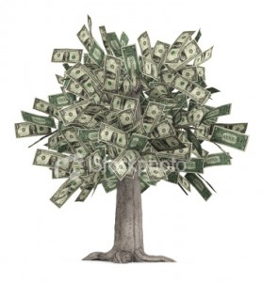
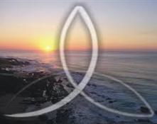
Бурхан?
Эсвэл Мөнгө?
Notes:
Our happiness comes from whether we seek God or money. Which of these two do you seek more: knowing God or accumulating wealth?
Which pursuit takes more of your time? Or think about more?
Are you more interested in passing on to your children Jesus or money?

Slide 67
"Бусдын төлөө л амьдарсан амьдрал үнэ цэнэтэй" —Алберт Эйнштэйн

Slide 68
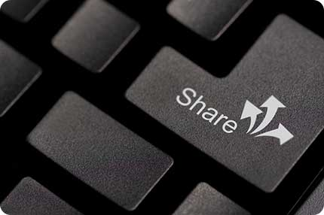
Share!

Slide 69
Номлох Ухаан • BibleStudyDownloads.org
Та энэхүү слайдыг үнэ төлбөргүй татаж авна уу!
Notes:
OT Preaching (op)

